Slide 1
Totally Organized
Learning Management System Project
Corey, Vernon, Alexis, Norma, Rohan

Slide 2
Modern Hierarchical Programming Team
Team Manager
Vernon
Team Leader
Corey
Secretary/Programmer
Alexis
Secretary/Programmer
Norma
Secretary/Programmer
Rohan
Technical
Nontechnical

Slide 3
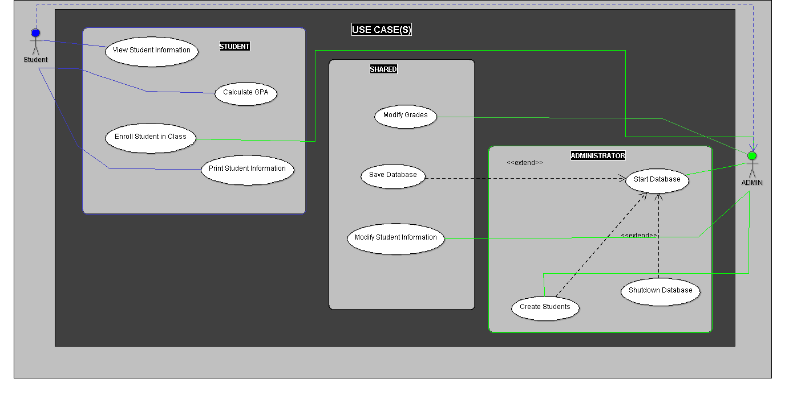

Slide 4
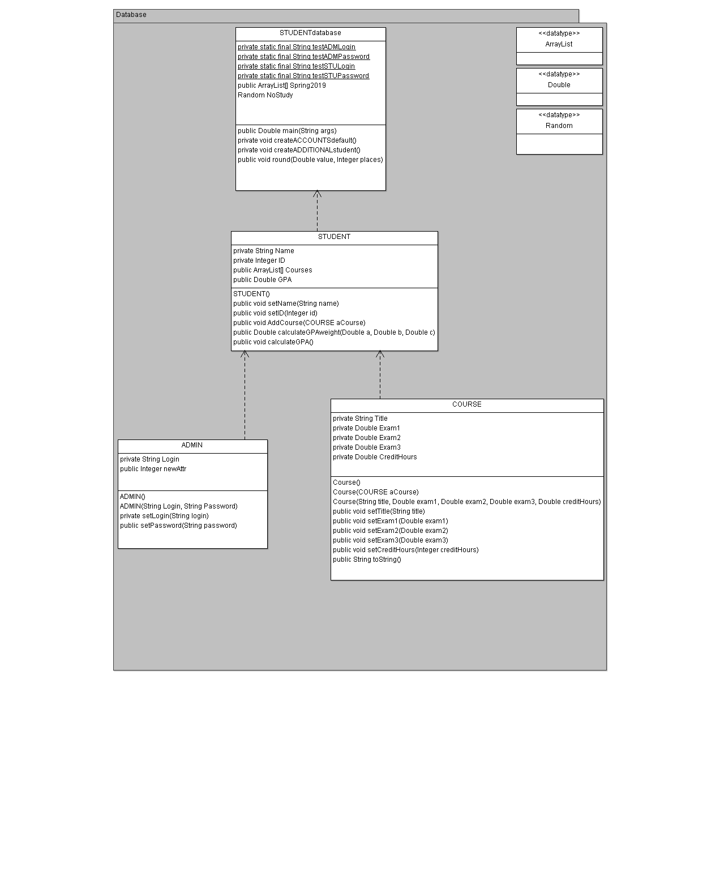

Slide 5
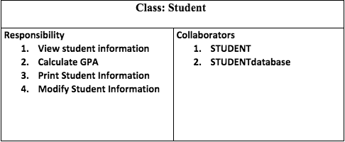
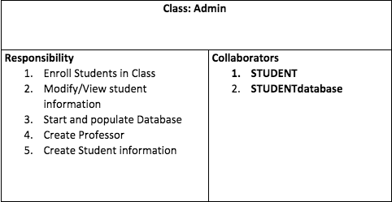
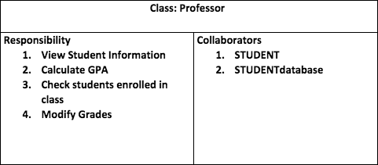
CRC Cards

Slide 6
SPMP document outline:
Introduction
Team introduction
Purpose/deliverables of the project
Constraints
Project overview
Project summary
Project Organization
Role and responsibilities of each team member
Project responsibilities
Process model
Project Schedule
Team meetings
Work breakdown
Risk Management
Common risks
Risks in each phase and the prevention of each risk.
Technical Process
The methods, tools, and techniques that are used during the project. (UML diagrams, what type of programming language, ect.

